Slide 1
Investment Manager Robot Based on LLM
Team B3
Yongzhao Mo-ym2918 Yicheng Wang-yw4102
Jinyu Xu-jx2556 Yuhan Xie-yx2850
Jinyu Chen-jc6186 Jiankun Sun-js6418
Notes:
Hello, my name is Yuhan and this is team b.3. today ill go over the investment roboadvisor project with you

Slide 2
Contents
1
Overview
2
Chatbot Development
3
Asset Allocation Model
4
Demo
Notes:
For this presentation, I will start by giving an overview of our project as well as the chatbot development section. After that I will pass it on to Yongzhao to talk about the asset allocation model and finally ill show a quick demo of the full workflow.

Slide 3
Overview
Who do we serve?
University/College student group
What kind of products should we build?
key steps need to be taken including training natural language processing models, establishing asset allocation algorithms, developing web applications, and constant iterations and optimizations.
What problems do we need to solve?
Lack of financial literacy and experience, requiring tailored financial education and guidance.
Poor monthly budgeting, leading to overspending at the start and tight funds by month-end.
No habit of making financial plans, resulting in disorganized finances.
Notes:
So lets begin: Our chatbot is an investment advisor and our target client is university or college students, like us.
For this user segment, some common problems for their investments are the lack of experience, limited budget and lack of financial plans. The product that we will build will help provide a tailored investment plan for our users. All our customers need to do is to have an interactive conversation with the bot.
The steps that we will be taking are training the LLM with prompt engineering, establishing an asset allocation algorithm and developing web applications.

Slide 4
Chatbot Development
Prompt 1: Directed Conversation
Prompt 2: Extract Insights
A directed conversation with customers by asking them questions from a predefined list in a natural way.
The system extracts insights from unstructured, natural language text in chat logs.
What is prompt engineering?
A technique used to detailed instructions to direct AI models toward desired outcomes.
Essential for accurate, relevant, or creative responses in AI tasks.
Prompt 3: Explain Optimization
The model explains optimization results by transforming structured parameters into fluent, unstructured language.
Notes:
Firstly, let me start by introducing prompt engineering, it is a technique that is used to get the desired outcomes while interacting with AI models, like chatGPT. It is very important for getting accurate, relevant and creative responses.
In this workflow, there are three prompts required: firstly, we need the llm to ask relevant questions for us while talking to the user; next is when the conversation is completed, we need the llm to extract useful information from the chat history; finally when our optimization model outputted a table of suggested investment portfolio, we need the llm to transform the table into a fluent language.

Slide 5


Chatbot Development
Prompt 1: Directed Conversation
A directed conversation with customers by asking them questions from a predefined list in a natural way.
What are your main financial goals?
How much do you want to keep as funds for emergencies?
What is your comfort level with investment risk? (very low, low, medium, high, very high)
What is your expected rate of return?
What kind of investment period you are looking for? (1-3 years,3-5 years, over 5 years)
Is your investment plan short-term, medium-term, or long-term?
What are your preferred industries? And what is the level of preference? (not interested, a little interested, moderately interested, very interested, extremely interested)
…
Notes:
For the first prompt, we have a predefined list of questions that we want the llm to ask the user, the llm will consider this as well as the user input to make a smooth conversation.

Slide 6
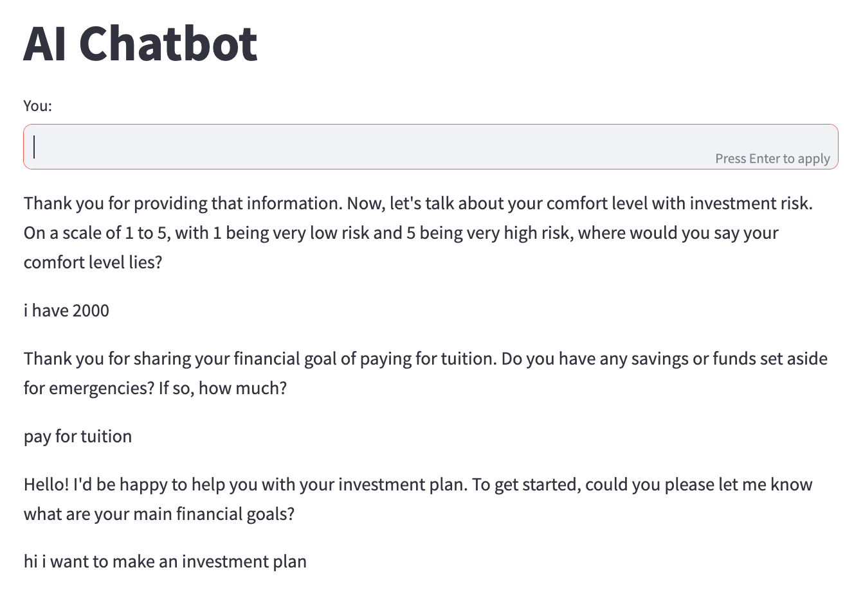
Chatbot Development
Prompt 1: Directed Conversation
A directed conversation with customers by asking them questions from a predefined list in a natural way.
Notes:
This is an example of how the chat will look like. One thing to note is for our interface, we have structured it to make the chat history read from the bottom to the top.

Slide 7
Chatbot Development
Prompt 2: Extract Insights
The system extracts insights from unstructured, natural language text in chat logs.
We quantify some of the user answers using the following criteria:
Risk Tolerance | Volatility
Very low | 5%
Low | 10%
Medium | 15%
High | 20%
Very high | 25%
Investment Period | Volatility Adjustment Factor
1-3 years | 0.7
3-5 years | 1.0
over 5 years | 1.3
Preference Level | Weight
A little interested | 1 - 10%
Moderately interested | 11 - 30%
Very interested | 31 - 50%
Extremely interested | 51 - 100%
Notes:
For prompt2, since some answers from the user will need to be quantified, we ask the llm to consider these criteria while transforming the user input.

Slide 8





Chatbot Development
Prompt 2: Extract Insights
The system extracts insights from unstructured, natural language text in chat logs.
Example output
Money Budget | Emergency Money | Investment Period | Risk Tolerance | Industry Preference | Preference Level | Expected Return
5000 | 1000 | 1-3 year | 20% | healthcare | 11% - 30 % weight | 30%
Notes:
Here is the flow of prompt2, we use the llm to extract from the chat and structure it into a json format string, then we output it into an excel file, which looks like this.

Slide 9

Chatbot Development
Asset | Weight
SHV US Equity | 0.4
XLV US Equity | 0.31
XLK US Equity | 0.11
USO US Equity | 0.1
XLE US Equity | 0.05
ROBO US Equity | 0.03
Prompt 3: Explain Optimization
The model explains optimization results by transforming structured parameters into fluent, unstructured language.
Example
Model
Output
Row | Constrained Optimization
Total Return | 0.459938569289775
Sharpe Ratio | 0.0296063464276184
Volatility | 0.00685717259460531
Average Turnover | 0.00214935903459497
Max Turnover | 0.354329956891809
Average Return | 0.000241299873397819
Max Drawdown | 0.178491685487022
Notes:
Now we move on to promp3, here is an example ourtput from the model, one stating the suggested weight of each etf and another showing the expected return, volatility and other information, these two table as also in an excel file

Slide 10
Chatbot Development
Prompt 3: Explain Optimization
JSON reads some assets and the proportion to be allocated. Please imitate the professional tone of the fund manager and help me explain the results of asset allocation for my clients.
The model explains optimization results by transforming structured parameters into fluent, unstructured language.
Notes:
For prompt3, the flow is we first transfrom the excel file into a json formatted string, then we input that string to the llm with this instruction. Asking it to explain the result of the allocation to the user. Then it will use one paragraphs or two to describe it in the chat. This is the main work for the chatbot, now ill pass it on to yongzhao.

Slide 11
Asset Allocation Model
Data Loading
Time Horizon: 12/06/2016 – 10/31/2023 daily price data
Underlying Assets: 27 ETFs
Equity: Large-cap, Mid-cap, Small-cap, Europe, Asia
Sector-specific: Tech, Healthcare, Finance, Real Estate, Consumer, Energy, Industrials, Materials, Communication, Utilities
Bonds: Government, Corporate, High-yield
Commodity: Gold, Oil, Agriculture
International: International, Emerging Markets
Thematic: ESG, AI, Biotech
Cash: Cash

Slide 12
Asset Allocation Model
Parameters Loading from Prompt 2
Example output
Money Budget | Emergency Money | Investment Period | Risk Tolerance | Industry Preference | Preference Level | Expected Return
5000 | 1000 | 1-3 year | 20% | healthcare | 11% - 30 % weight | 30%
Cash Ratio | Volatility Adjustment Factor | Volatility | Industry Preference | Expected Return
1000/5000 * 0.8 = 16% | 0.7 | 20% * 0.7 = 14% | healthcare min weight: 11% healthcare max weight: 30 % | 30%

Slide 13
Asset Allocation Model
Optimization Models in Backtesting Workflow
Min&Max ETFs Weights
Weights Sum Constraint
Expected Return
Max Volatility
Constraints
Strict Constraints
Penalty Terms
Constraints
Type
Constrained Optimization Model
Mean-variance Optimization
Small deviations on ETFs weights
Markowitz
Model
Mean-variance Optimization
Robust Optimization Model
Mean-variance Optimization
Robust term to handle uncertain expected returns
Optimization
Models

Slide 14
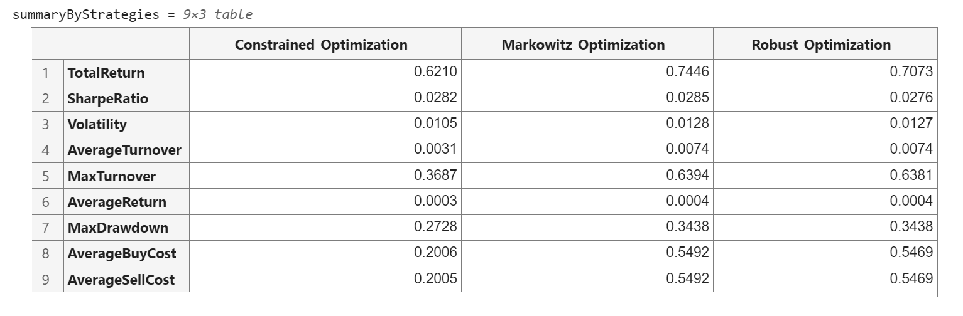
Asset Allocation Model
Backtesting Results
Select the best strategy with highest return

Slide 15
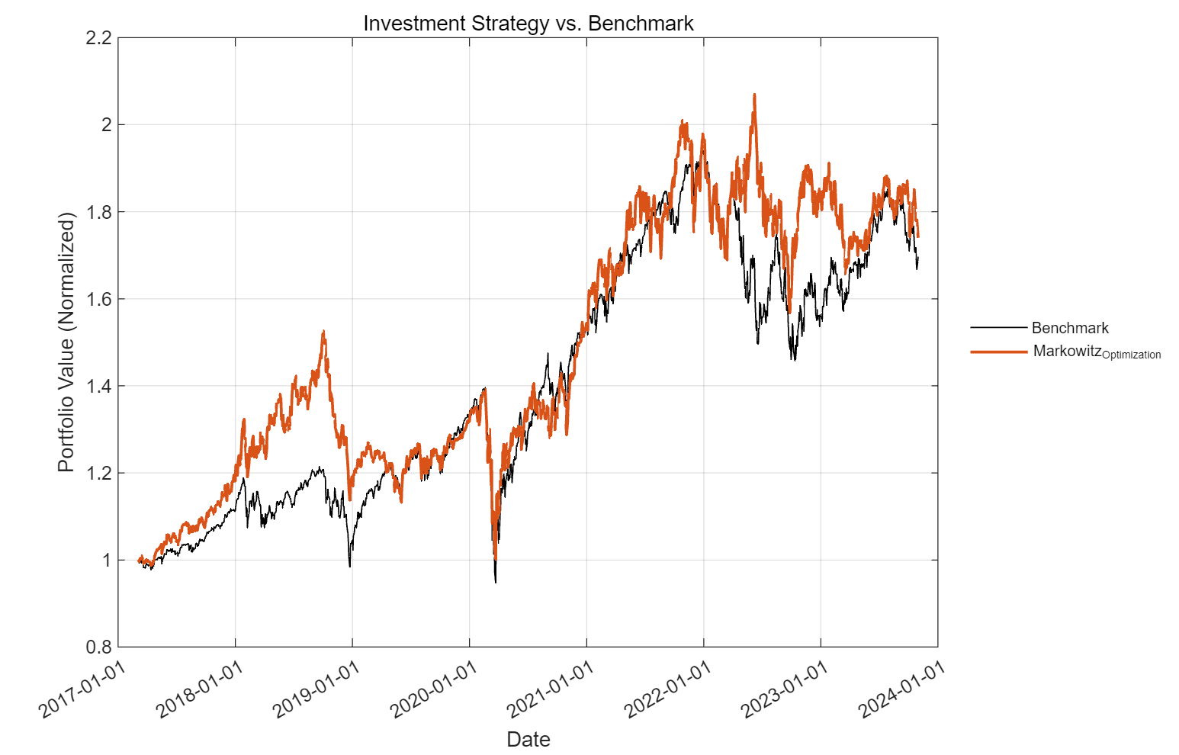
Asset Allocation Model
Backtesting Results
Benchmark =
60% SPY +
40% GOVT
(U.S. Treasury Bond)

Slide 16
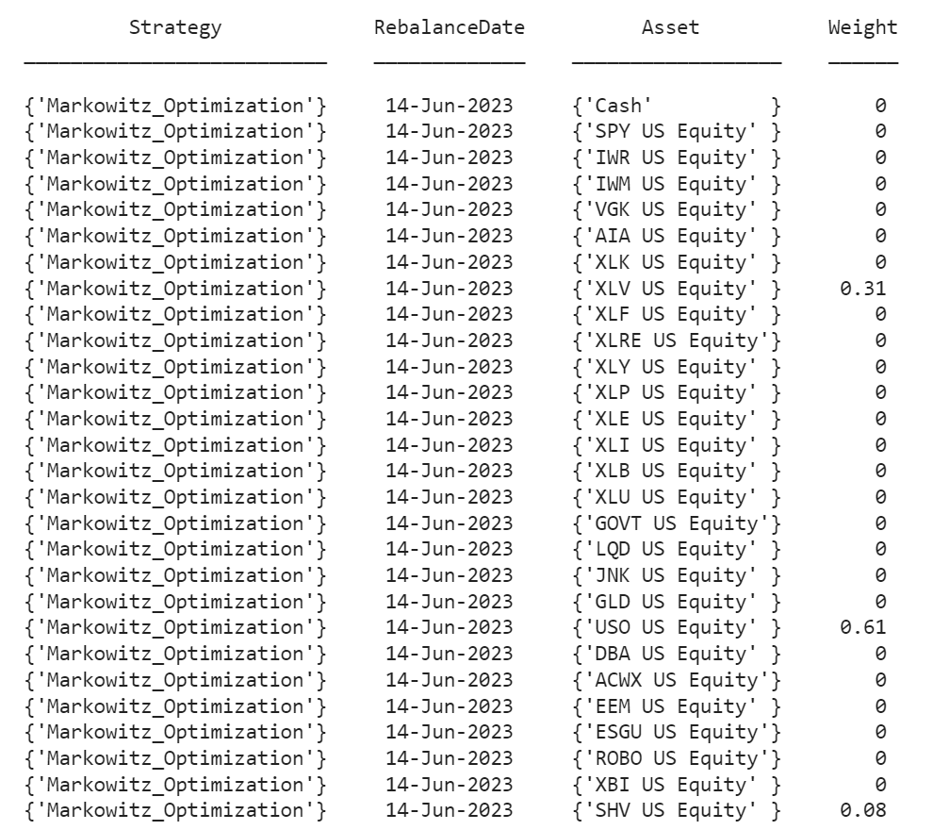
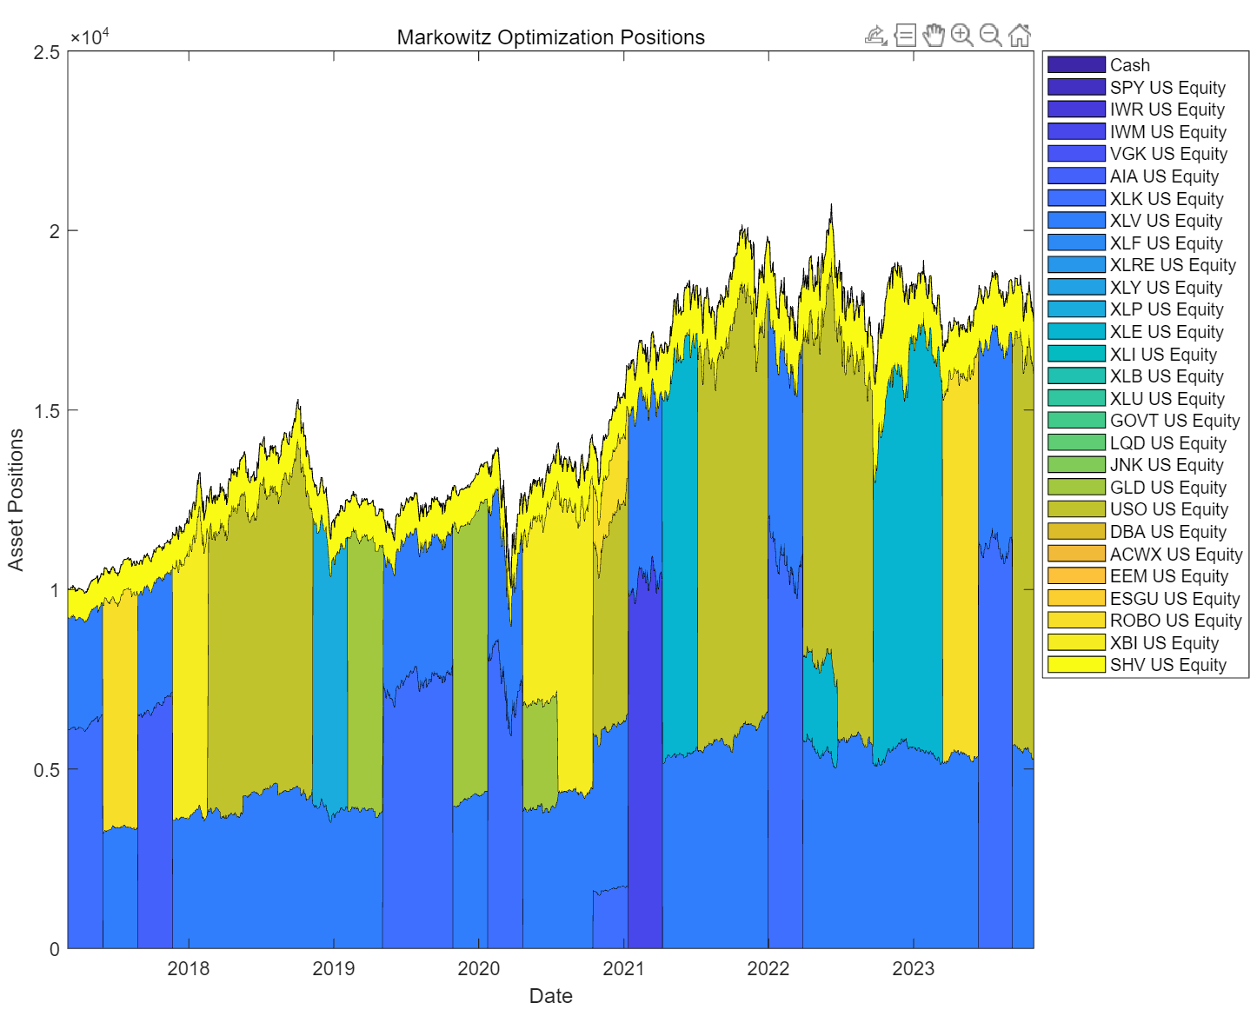
Asset Allocation Model
Backtesting Results

Slide 17
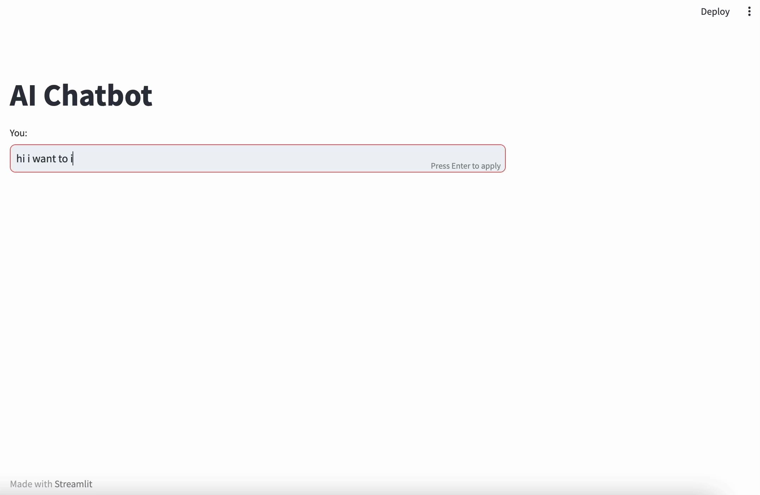
Demo
Notes:
Here is a quick demo of the full workflow. first, I act as a user to chat with the bot, answering the questions. The questions generated are based on prompt 1.
when it collects all the info, it will say thank you for providing all the necessary information. Then prompt 2 will instruct it to constrcut the user information excel.
this will take a while since now the model is running the optimization based on what it just collected. After the model outputted the results prompt 3 help with explaining the results
here are the final responses . we also included two charts to visualize our result.

Slide 18
Investment Manager Robot Based on LLM
Thank you!

